Slide 1
PARAMEDIC SUSTAINMENT PROGRAM IPR #1

Slide 2
Agenda
BACKGROUND
PROBLEM STATEMENT
TRAINING JUSTIFICATION
TRAINING PLAN
GTA APPROVAL
TRAINING PARTNERSHIPS
PROGRAM STATUS

Slide 3
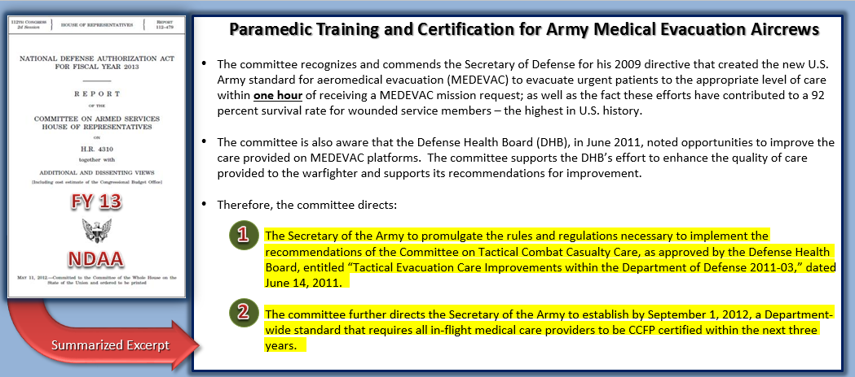
Background

Slide 4
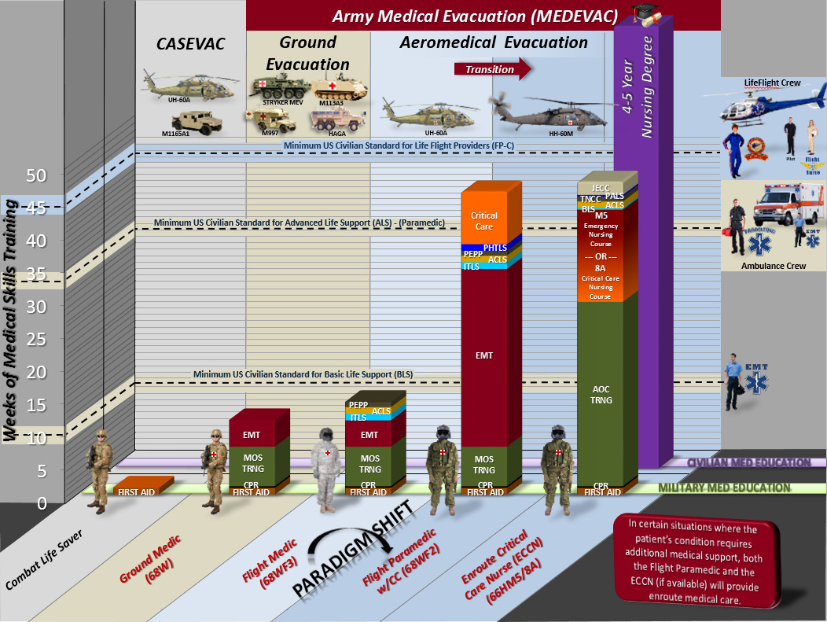
Background

Slide 5
Problem Statement
The certifications, capabilities, and skills held by Army Flight Paramedics require additional and specialized training in order to maintain proficiency in medical tasks and provide the best care for our nation’s warfighters. While current sustainment training options in Joint Base San Antonio, TX provide currency, they do not enable proficiency in required medical tasks.

Slide 6
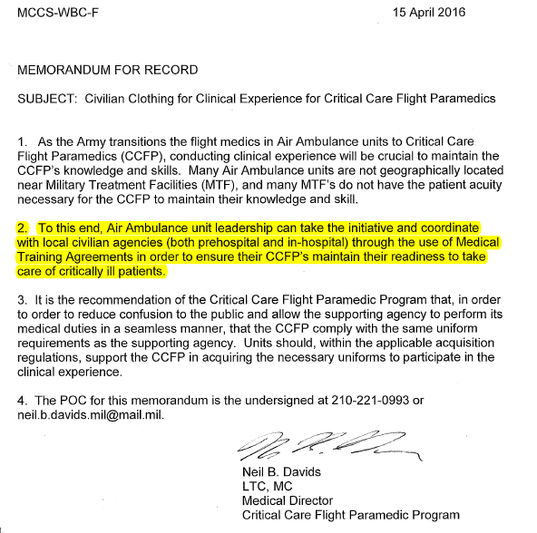
Training Justification
References:
Command Brief, Medical Evacuation Proponency Directorate
LTC Neil Davids, AMEDD C&S CCFP Program Director

Slide 7
Marne DUSTOFF Paramedic Sustainment Training
The C/2-3 AVN REGT Paramedic Sustainment Program (PSP) consists of clinical rotations between medical facilities and an EMS ambulance service. Each location presents a variety of unique medical experiences, providing Paramedics with both simulated and real-world opportunities to exercise their advanced, perishable medical skills.

Slide 8
Training Partnerships
Chatham Emergency Medical Services- Chatham EMS service is the region’s largest and most widely used Emergency Medical Service. This company performs an estimated 45,000 calls per year, ranging from trauma, behavioral health, and child births. The Service peak deploys 18 ambulances in a region with over 285,000 residents.
Training Opportunities- Paramedics will have a joint partnership with Chatham in the most beneficial training offered. Serving as a pre-hospital professional, each Paramedic will have opportunities to closely replicate the autonomy that they will face in combat. Paramedics will be empowered with decision making with limited assistance from higher echelons of care.
Memorial Health University- Memorial Health is the only Level 1 Trauma facility in Southeast Georgia. With the coordination assistance of Chatham EMS, our Paramedics will also be working with Registered Nurses (RN) inside the Emergency Department.
Training Opportunities- Paramedics will have opportunities to engage in cardiac, trauma, psychiatry, pediatrics, and triage. Paramedics will also have opportunities to cycle through various departments and acquire various skill sets with a wide variety of patient cases.

