Slide 1
An AMT EXCLUSIVE: Race to the Top

Slide 2
What is Race to the Top?
Evidenced-based program
Input from:
Medical experts
Medical centers
Biomedical manufacturers

Slide 3
What is Race to the Top?
8 Pillars of Success:
Immediate recognition of sudden cardiac arrest
911 activation, “First-Care” hands-only CPR, GPS to the Rescue
Community access to and utilization of AEDs
Pit crew resuscitation by EMS providers
Deployment of advanced practice paramedics
Advanced biomedical tools
Immediate provider feedback
Community and caregiver recognition

Slide 4
It all began in 2014...
Measured and reported ROSC only
High variability in execution of resuscitative efforts
No focused resources, training, education, or data collection
Concerted effort of how we can do better...

Slide 5
Timeline—where we started
Mechanical CPR (Lucas device) deployed- November 2014
CARES Registry - December 2014
Zoll Monitor X Series deployed- December 2015
Take Heart America Workshop- March 2016
100% Case Review on all cardiac arrest cases- AMT East- April 2016
ResQPod Implementation- June 2016
PulsePoint Launch- July 2016
Comprehensive Case Analysis
Analyzing 152 standardized data points per event- January 2017
Take Heart America Workshop- June 2017
ResQCPR Implementation- June 2018

Slide 6
Timeline—where we are today
Weekly Quality Improvement Meeting
Leadership of AMT
Leadership of Peoria Fire
Medical Director
Resuscitation academy- February 2018
Joint resuscitation academy with first responders- May 2018
First responder ResQCPR implementation- June 8, 2018
Positive feedback with recognition for strict adherence to protocol- July 2018
Monthly CE performance improvement plan- August 2018
Airway system (i-gel) protocol implementation- September 4, 2018

Slide 7
How do we measure success? CARES DATA
Measured Metrics
Total arrests (Non-traumatic)
Witnessed vs. unwitnessed arrests
Underlying rhythm
V-fib/V-tach
Asystole
Other underlying rhythms (PEA, AED unshockable )
Key Indicators
Sustained ROSC in the field
Sustained greater than 20 minutes
Sustained at turnover of care
Admitted to hospital
Discharged alive
CPC scores 1 or 2
CPC scores 3 or 4

Slide 8
Detailed breakdown of events
Witnessed Arrests
Bystander
V-fib/V-tach
Asystole
Other rhythms (mostly PEA)
EMS Provider
V-fib/V-tach
Asystole
Other rhythms (mostly PEA)
V-fib/V-tach
Shockable rhythms
"Utstein criteria"
Benchmark

Slide 9
Utstein Survival Report: 2018
Total lives saved in 2018 = 30 (19 in Peoria)​
CPC score of 1 or 2: 28 (17 in Peoria)​
CPC score of 3 or 4: 2 (2 in Peoria)​
Peoria data from January 1, 2018-December 31, 2018​
Survival rate of unwitnessed cardiac arrests: 4.2% (n=3/72)​
Survival rate of bystander witnessed cardiac arrests: 31.7% (n=13/41)​
Survival rate of Utstein patients: 68.8% (n=11/16)
Survival rate of Utstein bystander patients: 87.5% (n=7/8)

Slide 10
AMT Bystander Witnessed Asystole Cardiac Arrests
 | Total Attempts AMT-East (Peoria) 89,827 | Bystander Witnessed Asystolic AMT-East (Peoria) 12,137 | Field ROSC AMT-East (Peoria) 3,574 | Field ROSC % AMT-East (Peoria) 29.4% | ICU Admits AMT-East (Peoria) 2,969 | ICU Admits % AMT-East (Peoria) 24.5% | Discharged Alive AMT-East (Peoria) 416 | Discharged Alive % AMT-East (Peoria) 3.4% | % of Field ROSC Discharged Alive AMT-East (Peoria) 15.1%
2015 | 228 (109) | 24 (8) | 3 (2) | 12.5% (25%) | 3 (2) | 12.5% (25%) | 0 (0) | 0% (0%) | 0% (0%)
2016 | 241 (129) | 23 (13) | 5 (5) | 21.7% (38.5%) | 8 (6) | 34.8% (46.2%) | 0 (0) | 0% (0%) | 0% (0%)
2017 | 235 (124) | 15 (6) | 4 (2) | 26.7% (33.3%) | 2 (1) | 13.3% (16.7%) | 1 (1) | 6.7% (16.7%) | 25% (50%)
2018 | 265 (129) | 27 (12) | 11 (6) | 40.7% (50%) | 6 (5) | 22.2% (41.7%) | 1 (1) | 3.7% (8.3%) | 9.1% (16.7%)
AMT-East
(Peoria)
Discharged Alive: ​
CPC score 1 or 2: 1 (1) (217)​
CPC score 3 or 4: 0 (0) (186)
CPC Unknown: (13)
All data in yellow is 2018 CARES national data
Updated 5/30/2019

Slide 11
AMT Bystander Witnessed PEA Cardiac Arrests
 | Total Attempts AMT-East (Peoria) 89,827 | Bystander Witnessed PEA AMT-East (Peoria) 10,834 | Field ROSC AMT-East (Peoria) 4,850 | Field ROSC % AMT-East (Peoria) 44.8% | ICU Admits AMT-East (Peoria) 4,207 | ICU Admits % AMT-East (Peoria) 38.8% | Discharged Alive AMT-East (Peoria) 1,484 | Discharged Alive % AMT-East (Peoria) 13.7% | % of Field ROSC Discharged Alive AMT-East (Peoria) 30.6%
2015 | 228 (109) | 27 (16) | 7 (4) | 25.9% (25%) | 10 (5) | 37% (31.3%) | 5 (3) | 18.5% (18.8%) | 71.4% (75%)
2016 | 241 (129) | 31 (12) | 8 (4) | 25.8% (33.3%) | 11 (7) | 35.5% (58.3%) | 1 (1) | 2.8% (8.3%) | 12.5% (25%)
2017 | 235 (124) | 35 (19) | 10 (7) | 28.6% (65.4%) | 14 (7) | 40% (36.8%) | 4 (1) | 11.4% (5.3%) | 40% (14.3%)
2018 | 265 (129) | 30 (13) | 11 (6) | 36.7% (46.2%) | 8 (4) | 26.7% (30.8%) | 2 (1) | 6.7% (7.7%) | 18.2% (16.7%)
Discharged Alive: ​
CPC score 1 or 2: 2 (1)​ (1,114)
CPC score 3 or 4: 0 (0) (335)
CPC Unknown: (35)
All data in yellow is 2018 CARES national data
Updated 5/30/2019

Slide 12
Where are we today?
Resuscitation Academy- February 2018
Mandatory annual competency for all field providers in AMT- East
Off-site training at outer markets
Seven trained field staff now instructing (1 PHRN, 4 paramedics, 3 EMT-Basics)
Joint resuscitation academy with fire departments
Streator fire (May 2018), Peoria Fire (June 2018), Chillicothe Fire (August 2018)
Written reviews on all cardiac arrests- May 1, 2018
Available to all crew members
ResQCPR Implementation- June 8, 2018
Positive feedback for strict adherence to protocol initiative with recognition- July 2018
Thank-you letters, electronic message board recognition, posting recognition in all markets
Monthly updates for noted trends needing improvement in Race to the Top Meeting- August 2018
Newsletter, monthly CE, bulletin board updates
Revised resuscitation academy for Peoria Fire cadets- August 2018
Igel protocol implementation- September 4, 2018
Reporting ROSCs at weekly Race to the Top QI Process- September 6, 2018
Joint resuscitation academy with area volunteer first responders
Dunlap (January 2019), Bartonville (February 2019), Limestone (April 2019), Delavan (June 2019), Creve Couer (June 2019), Peoria Heights (coming July 2019), Logan-Trivoli (coming August 2019), Schaeferville/South Pekin (coming August 2019), Chillicothe (coming August 2019)
Deployment of Advanced Practice Paramedics- June 2019

Slide 13
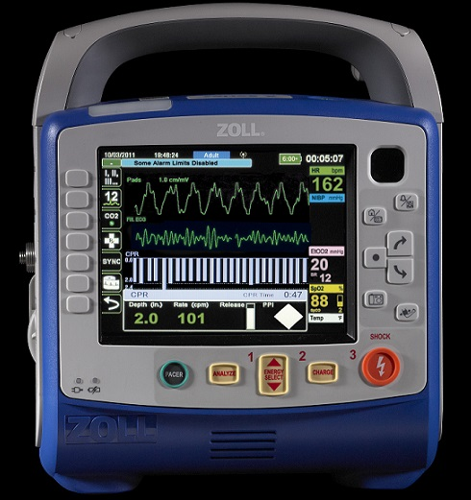
Tools We Utilize
Zoll X-Series monitor
See-thru CPR
CPR biofeedback
Data upload capabilities
Cardiac pacing capabilities
ResQCPR System
Impedance threshold device (ResQPod)
Active compression, decompression device (ResQPump)
Airway system
I-gel blind insertion gelatinous LMA
Continuous end tidal waveform capnography
Lucas Device
Automated CPR device
IV/IO
Advanced Cardiac Life Support approved medications (Epinephrine, Amiodarone, Sodium Bicarbonate, Narcan, Dopamine, Dextrose)

Slide 14
ResQCPR
What is ResQCPR?
ResQCPR on a cadaveric model

Slide 15
Quality Assurance vs. Quality Improvement
ASSURANCE
VALIDATING OR “ASSURING” THAT ALL COMPONENTS OF PROTOCOL WERE COMPLETED
–SIMPLE YES OR NO ANSWER
IMPROVEMENT
ASKS THE WHY?
BOTH ARE MEANINGLESS IF YOU DON’T TRACK, TREND, AND THEN DO SOMETHING ABOUT IT
How do we create our own best practice with data driven changes?

Slide 16
Race to the Top ResQCPR Protocol
T=0 | Compressions are 8:1 – started immediately with ResQPump ACD-CPR Device at a rate of 80 bpm with changing rescuer every 2 minutes.
T= 1 min | Monitor applied within 1 minute of patient contact at the first pulse check. Upon AMT arrival, Zoll monitor will be applied right away with accelerometer being left off and pads applied in the anterior/posterior position.
T= 1 min | Airway system completed—Igel supraglottic airway inserted with ResQPOD and inline capnography attached to the BVM. Be cognizant to hit the CO2 button on the Zoll monitor to activate end tidal capnography. The Igel will not be used in any pediatric patient smaller than 50 kg Provide asynchronous ventilations once every six seconds.
T= 2 min | Defibrillation at 2 minutes of patient contact if pulseless vfib/vtach Defibrillation immediately if witnessed arrest per 9-1-1 response team member Defibrillation after 2 minutes of CPR if unwitnessed arrest
T= 5 min | IV access within 5 minutes of patient contact, if unable to establish an IV, IO placement to the humeral head
T= 6 min | Medications per the ACLS algorithm within 6 minutes of patient contact Epinephrine 1 mg of 1:10,000 every 3-5 minutes Amiodarone 300 mg if vfib/vtach pulseless arrest after 2nd defibrillation attempt. Second dose of Amiodarone is 150 mg for recurrent vfib and after 3rd defibrillation attempt. Consideration of Narcan should be given if suspected opioid overdose. Sodium Bicarbonate should be given if known renal failure, suspected ASA overdose, and tricyclic antidepressant overdose.
T=10 min | Lucas device should be applied and in less than 10 seconds with accelerometer pad directly under the Lucas arm/suction cup. The Lucas device will also be applied earlier if the following occurs: If ROSC is obtained and patient is stabilized, prepare for transport and apply Lucas device without activation. If patient is being transported and CPR is still being done, immediate placement of Lucas device should be done.

Slide 17
QI Process:
100% review of all cardiac arrests in AMT-East
Data upload
Chart review
Weekly discussion via QI process with Race to the Top Committee
Data input (watching trends)
Patient follow-up
Crew follow-up

Slide 18
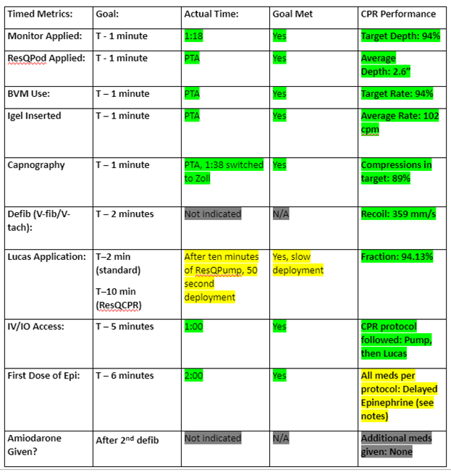
WE DON’T KNOW WHAT WE DON’T MEASURE

Slide 19
Things are not always as they seem...

Slide 20
QI: CPR Trend Report

Slide 21
Using Data to Drive Change
May 1, 2018- July 25, 2018
Attempted Resuscitation: 68
No ROSC: 44 patients (64.7%)
ROSC: 24 patients (35.3%)
Of the 24, 20 patients (83.3%) maintained ROSC
Of the 68 Resuscitations:
18 (26.5%) had no ventilations recorded- failed airway seal
15 (22.1%) had variable ventilations recorded
35 (51.5%) had confirmed airway seal

Slide 22
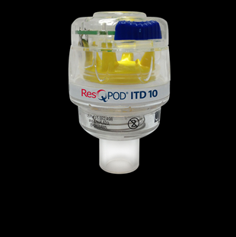
Ventilatory Seal and the Effectiveness of ResQPOD
24 Patients obtained ROSC
20 (83.3%) had confirmed airway seal
1 (4.1%) had variable airway seal
3 (12.5%) unable to determine due to lack of Capnography
44 patients did not obtain ROSC
17 (38.6%) failed airway seal
15 (34.1%) intermittent airway seal
12 (27.3%) No Data Available- Capnography not placed or placed too late to be evaluated
ResQPOD requires a positive airway seal to enhance perfusion by enhancing negative intrathoracic pressure
No Seal= No Negative Pressure

Slide 23
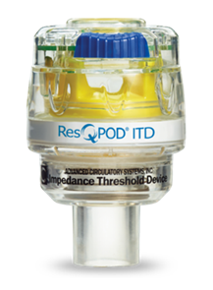
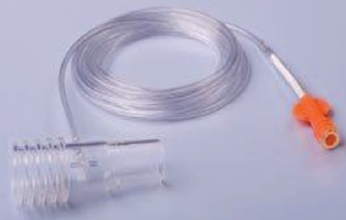
New Airway Management Protocol

Slide 24
So where are we now?

Slide 25
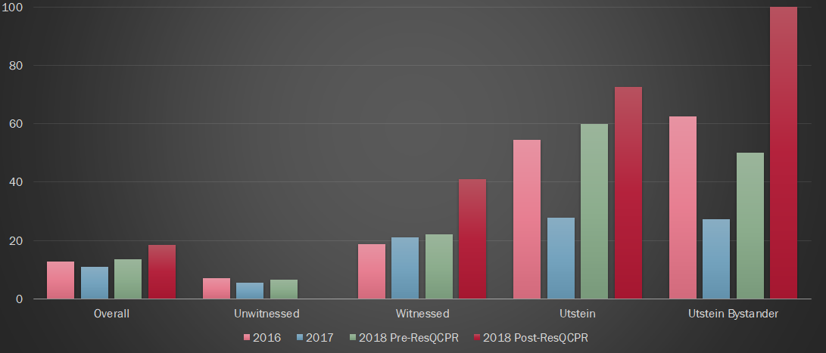
City of Peoria Cardiac Arrest Survival

Slide 26
AMT All Cardiac Arrests
 | Total Attempts AMT- East (Peoria) 89,827 | V-fib/ V-tach AMT-East (Peoria) 16,132 | Asystole AMT-East (Peoria) 43,650 | PEA AMT-East (Peoria) 27,017 | Field ROSC AMT-East (Peoria) 26,913 | Field ROSC % AMT-East (Peoria) 30.0% | ICU Admits AMT-East (Peoria) 24,729 | ICU Admits % AMT- East (Peoria) 27.5% | Discharged Alive AMT- East (Peoria) 8,788 | Discharged Alive % AMT- East (Peoria) 9.8% | % of Field ROSC Discharged Alive AMT- East (Peoria) 32.7%
2015 | 228 (109) | 57(26) | 94(40) | 77(43) | 53 (28) | 23.2% (25.7%) | 65 (37) | 28.5% (33.9%) | 25 (17) | 11.0% (15.6%) | 47.2% (60.1%)
2016 | 241 (129) | 47(25) | 101(60) | 93(44) | 59(39) | 24.5% (30.2%) | 70 (48) | 29.0% (37.2%) | 22 (19) | 9.1% (14.7%) | 37.3% (48.7%)
2017 | 235 (124) | 47(22) | 99(59) | 89(43) | 57 (33) | 24.3% (26.6%) | 65 (37) | 27.7% (29.8%) | 20 (11) | 8.5% (8.1%) | 35.1% (33.3%)
2018 | 265 (129) | 57(28) | 108(58) | 100(43) | 79 (42) | 29.8% (32.6%) | 80 (48) | 30.2% (37.2%) | 30 (19) | 11.3% (14.7%) | 38.0% (45.2%)
Discharged Alive:
CPC score 1 or 2: 28 (17) (6,952)
CPC score 3 or 4: 2 (2) (1,653)
Unknown: 0 (0) (183)
All data in yellow is 2018 CARES national data
Updated 5/30/2019

Slide 27
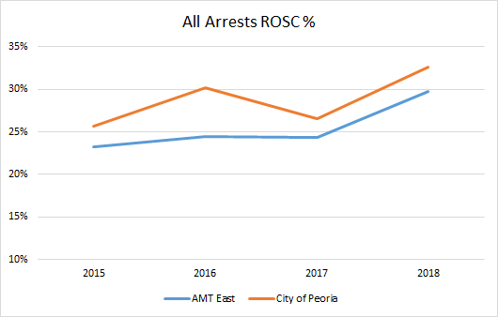
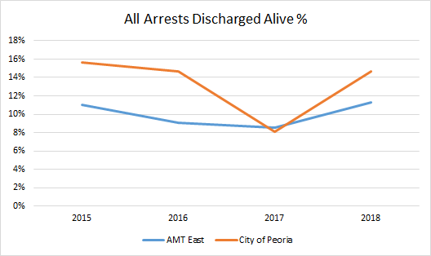

Slide 28
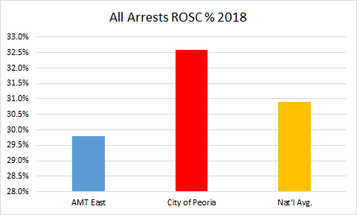
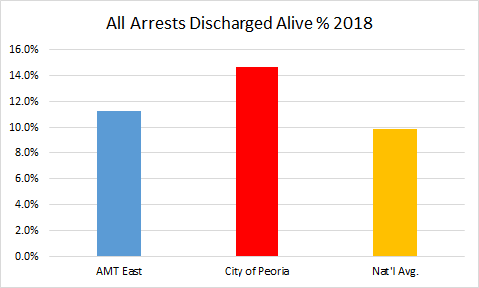

Slide 29
AMT Bystander Witnessed V-fib/V-tach Cardiac Arrests
 | Total Attempts AMT-East (Peoria) 89,827 | Bystander Witnessed Vfib/Vtach AMT-East (Peoria) 9,704 | Field ROSC AMT-East (Peoria) 5,123 | Field ROSC % AMT-East (Peoria) 52.8% | ICU Admits AMT-East (Peoria) 5,117 | ICU Admits % AMT-East (Peoria) 52.7% | Discharged Alive AMT-East (Peoria) 3,115 | Discharged Alive % AMT-East (Peoria) 32.1% | % of Field ROSC Discharged Alive AMT-East (Peoria) 60.8%
2015 | 228 (109) | 30 (13) | 15 (8) | 50% (61.5%) | 18 (11) | 60% (84.6%) | 10 (7) | 33.3% (53.8%) | 66.67% (87.5%)
2016 | 241 (129) | 22 (11) | 10 (6) | 45.5% (54.5%) | 11 (6) | 50% (54.5%) | 9 (6) | 40.1% (54.5%) | 90.0% (100.0%)
2017 | 235 (124) | 31 (18) | 13 (8) | 41.9% (44.4%) | 12 (9) | 38.7% (50%) | 6 (5) | 19.4% (27.8%) | 46.2% (62.5%)
2018 | 265 (129) | 33 (16) | 16 (11) | 48.5% (68.8%) | 20 (13) | 60.6% (81.3%) | 15 (11) | 45.5% (68.8%) | 93.8% (100%)
Discharged Alive: ​
CPC score 1 or 2: 14 (10) (2750)​
CPC score 3 or 4: 1 (1) (308)
CPC Unknown: (57)
All data in yellow is 2018 CARES national data
Updated 5/30/2019

Slide 30
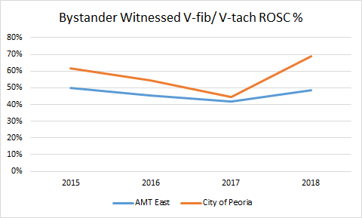
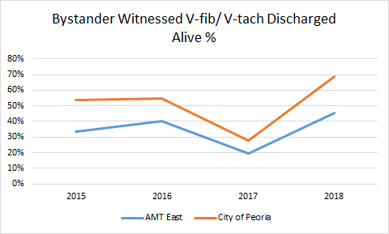

Slide 31
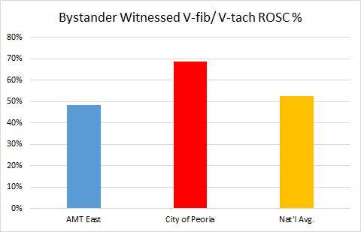
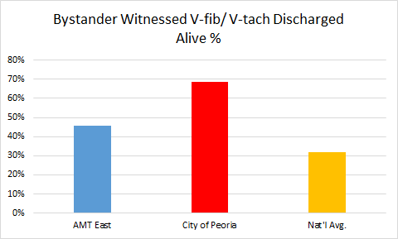

Slide 32
AMT All V-fib/V-tach Cardiac Arrests
 | Total Resuscitation Attempts AMT-East (Peoria) 89,827 | V-fib/V-tach Arrests AMT-East (Peoria) 16,132 | Field ROSC AMT-East (Peoria) 7,842 | Field ROSC % AMT-East (Peoria) 48.6% | ICU Admits AMT-East (Peoria) 7,813 | ICU Admits % AMT-East (Peoria) 48.4% | Discharged Alive AMT-East (Peoria) 4,580 | Discharged Alive % AMT-East (Peoria) 28.4% | % of Field ROSC Discharged Alive AMT-East (Peoria) 58.4%
2015 | 228 (109) | 57 (26) | 24 (14) | 25.0% (53.8%) | 28 (17) | 49.1% (65.4%) | 15 (11) | 26.3% (42.3%) | 62.5% (78.8%)
2016 | 241 (129) | 47 (25) | 17 (13) | 36.2% (52%) | 20 (14) | 42.6% (56%) | 14 (11) | 29.8% (44%) | 82.4% (84.6%)
2017 | 235 (124) | 47 (22) | 18 (9) | 38.3% (40.9%) | 15 (9) | 31.9% (40.9%) | 7 (5) | 14.9% (22.7%) | 38.9% (55.6%)
2018 | 265 (129) | 57 (28) | 29 (16) | 50.9% (57.1%) | 33 (21) | 57.9% (75%) | 21 (14) | 36.8% (50%) | 72.4% (87.5%)
All data in yellow is 2018 CARES national data
Discharged Alive: ​
CPC score 1 or 2: 20 (13)​ (4,036)
CPC score 3 or 4: 1 (1) (465)
CPC Unknown: (79)
Updated 5/30/2019

Slide 33
AMT All Asystolic Cardiac Arrests
 | Total Resuscitation Attempts AMT-East (Peoria) 89,827 | Asystolic Arrests AMT-East (Peoria) 43,650 | Field ROSC AMT-East (Peoria) 8,615 | Field ROSC % AMT-East (Peoria) 19.7% | ICU Admits AMT-East (Peoria) 7,504 | ICU Admits % AMT-East (Peoria) 17.2% | Discharged Alive AMT-East (Peoria) 1,051 | Discharged Alive % AMT-East (Peoria) 2.4% | % of Field ROSC Discharged Alive AMT-East (Peoria) 12.2%
2015 | 228 (109) | 94 (40) | 9 (4) | 9.6% (10.0%) | 9 (3) | 9.6% (7.5%) | 1 (0) | 1.1% (0%) | 11.1% (0%)
2016 | 241 (129) | 101 (60) | 14 (11) | 13.9% (18.3%) | 20 (14) | 19.8% (23.3%) | 0 (0) | 0% (0%) | 0% (0%)
2017 | 235 (124) | 99 (59) | 14 (8) | 14.1% (13.6%) | 9 (21) | 10.1% (15.3%) | 2 (2) | 2.0% (3.4%) | 14.3% (25%)
2018 | 265 (129) | 108 (58) | 19 (9) | 17.6% (15.5%) | 19 (12) | 17.6% (20.7%) | 4(3) | 3.7% (5.2%) | 21.1% (33.3%)
All data in yellow is 2018 CARES national data
Discharged Alive: ​
CPC score 1 or 2: 3 (2)​ (599)
CPC score 3 or 4: 1 (1) (432)
CPC Unknown: (20)
Updated 5/30/2019

Slide 34
AMT All PEA Cardiac Arrests
 | Total Resuscitation Attempts AMT-East (Peoria) 89,827 | PEA Arrests AMT-East (Peoria) 27,017 | Field ROSC AMT-East (Peoria) 10,456 | Field ROSC % AMT-East (Peoria) 38.7% | ICU Admits AMT-East (Peoria) 9,401 | ICU Admits % AMT-East (Peoria) 34.8% | Discharged Alive AMT-East (Peoria) 3,157 | Discharged Alive % AMT-East (Peoria) 11.7% | % of Field ROSC Discharged Alive AMT-East (Peoria) 30.2%
2015 | 228 (109) | 77(43) | 20 (10) | 26.0% (23.3%) | 28 (17) | 36.4% (39.5%) | 9 (6) | 11.7% (14.0%) | 45% (60%)
2016 | 241 (129) | 93 (44) | 28 (15) | 30.1% (34.1%) | 30 (20) | 32.3% (45.5%) | 8 (6) | 8.6% (13.6%) | 28.6% (40%)
2017 | 235 (124) | 89 (43) | 25 (16) | 28.1% (37.2%) | 40 (19) | 44.9% (44.2%) | 11 (4) | 12.4% (9.3%) | 44% (25%)
2018 | 265 (129) | 100 (43) | 31 (17) | 31% (39.5%) | 28 (15) | 28% (34.9%) | 5 (2) | 5% (4.7%) | 16.1% (11.8%)
Discharged Alive: ​
CPC score 1 or 2: 5 (2)​ (2,328)
CPC score 3 or 4: 0 (0) (756)
CPC Unknown: (84)
All data in yellow is 2018 CARES national data
Updated 5/30/2019

Slide 35
Timeline—where 2019 has taken us
Joint resuscitation academy training with volunteer fire departments
ResQPump implementation with outlying agencies
Dunlap Fire
Bartonville Fire
Limestone Fire
Chillicothe Fire
Peoria Heights Fire
Creve Coeur Fire (coming soon)
Follow up regarding status on patients obtaining ROSC and ICU admission
Crew recognition for neurologically intact discharges
Development of Advanced Practice Paramedics (super-resuscitators integration)
Trending new key targets for 2019 education
PEA arrests
CPR fraction
Expansion of ResQCPR
Engage stakeholders in a system-based "bundle of care" approach to sudden cardiac arrest survival (Take Heart America)
Bystander CPR
Dispatch
First responders
ED resuscitation
Hospital care

Slide 36
What we need
Take Heart America focuses on a multidisciplinary approach to improving cardiac arrest survival.
How can we improve upon this?
Where are our current identified barriers?
Identify health system stakeholders to help close the loop in the bundle of care approach
Better understanding of health care SCA efforts
Achieve best practice across the spectrum of care
Seamless QI across spectrum of care

Slide 37
